Slide 1
Windows Tech Series Managing Client Devices
Speaker 1
Title
Speaker 2
Title

Slide 2
Agenda
Day | Day 1 Deployment | Day 2 Management | Day 3 Security | Day 4 Windows for CSP
 |  |  |  | Deployment | Management | Security
Synopsis | Module 1 – Introduction | Module 1 – Base System Setup | Module 1 – Analysis Of Common Threats | Module 1 – Windows for SMB Partners
 | Module 2 – Applications & Updates | Module 2 – Configuration | Module 2 – Hardening Windows | Module 2 – Windows Ent. Subscription
 | Module 3 – Windows as a Service (WaaS) | Module 3 – Managing Client Devices | Module 3 – Advanced Threat Protection | Module 3 – Deployment
 | Module 4 – Browsers & Internet Security | Module 4 – Advanced management options I | Module 4 – Information Security (RMS/EDP) | Module 4 – Managing Updates
 | Module 5 – Secure Boot & Device Guard | Module 5 – Advanced management options II | Module 5 – Internet Security

Slide 3
Part 3 – Client Management
Set MDM Policies in Intune (WIP, Whitelist Apps..)
Publish LOB App and Business Store App in Intune
Get “Windows Store for Business” app from private store
Enroll Clients with Intune

Slide 4
OMA-DM

Slide 5




Windows 10 Mobile Management Architecture
MDM (Intune)
Provisioning
EAS
ConfigMgr
Service/Server
Device/OS
MDM Client
Provisioning Engine
EAS Client
WMI Bridge
Common Device Configurator
WMI providers
MDM Configuration Service Providers (CSP’s)
Common component
PC component
Notes:
So what is special about the MDM components in Windows 10 that makes this possible?
Looking a bit under the hood, the MDM stack is designed in such a way that whatever management tool you use in your Enterprise to set policies - for eg. Microsoft IT sets policies through MDM and also Exchange Active Sync – they all go through the same management layer <click> thus making automatic configuration resolution possible by the device.
<click>
System Center configuration manager is a popular tool and is widely used by many Enterprises including our own IT. We understand that you may not migrate immediately to MDM & so built a layer in the MDM platform that helps bridge WMI that System Center configuration manager uses to the capabilities that MDM provides
So what are the new features that Windows 10 MDM provides. For this, I want to rewind 8 months. Microsoft gave me a brand new laptop and a phone to install windows 10 builds on for testing and providing feedback. The first thing that I did when I got these devices was to connect to Microsoft Wifi, but it wouldn’t connect. I was only able to connect to the open Wifi network that gave me internet access. I realized that Microsoft IT wanted me to first enroll the device in MDM before I can connect to corporate Wifi. <click>
3

Slide 6

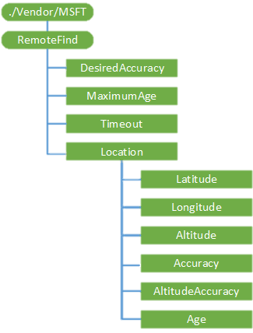

Windows 10 – OMA-DM Communication
Configuration Service Provider
A CSP is an interface to read, set, modify, or delete configuration settings on the device
SyncML
File with all information to configure CSP
SyncML
MDM Client
Common Device Configurator
MDM Configuration Service Providers (CSP’s)
MDM (Intune)

Slide 7
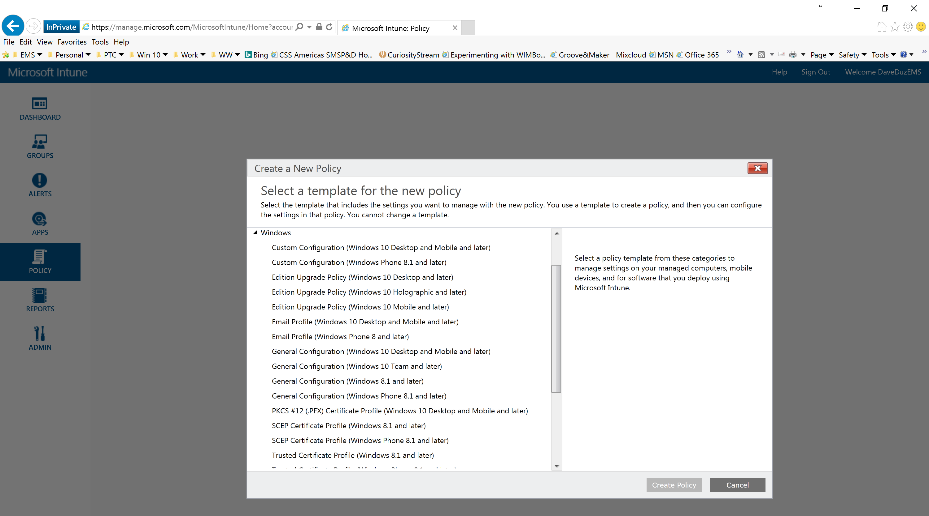
Notes:
So what is special about the MDM components in Windows 10 that makes this possible?
Looking a bit under the hood, the MDM stack is designed in such a way that whatever management tool you use in your Enterprise to set policies - for eg. Microsoft IT sets policies through MDM and also Exchange Active Sync – they all go through the same management layer <click> thus making automatic configuration resolution possible by the device.
<click>
System Center configuration manager is a popular tool and is widely used by many Enterprises including our own IT. We understand that you may not migrate immediately to MDM & so built a layer in the MDM platform that helps bridge WMI that System Center configuration manager uses to the capabilities that MDM provides
So what are the new features that Windows 10 MDM provides. For this, I want to rewind 8 months. Microsoft gave me a brand new laptop and a phone to install windows 10 builds on for testing and providing feedback. The first thing that I did when I got these devices was to connect to Microsoft Wifi, but it wouldn’t connect. I was only able to connect to the open Wifi network that gave me internet access. I realized that Microsoft IT wanted me to first enroll the device in MDM before I can connect to corporate Wifi. <click>
3

Slide 8
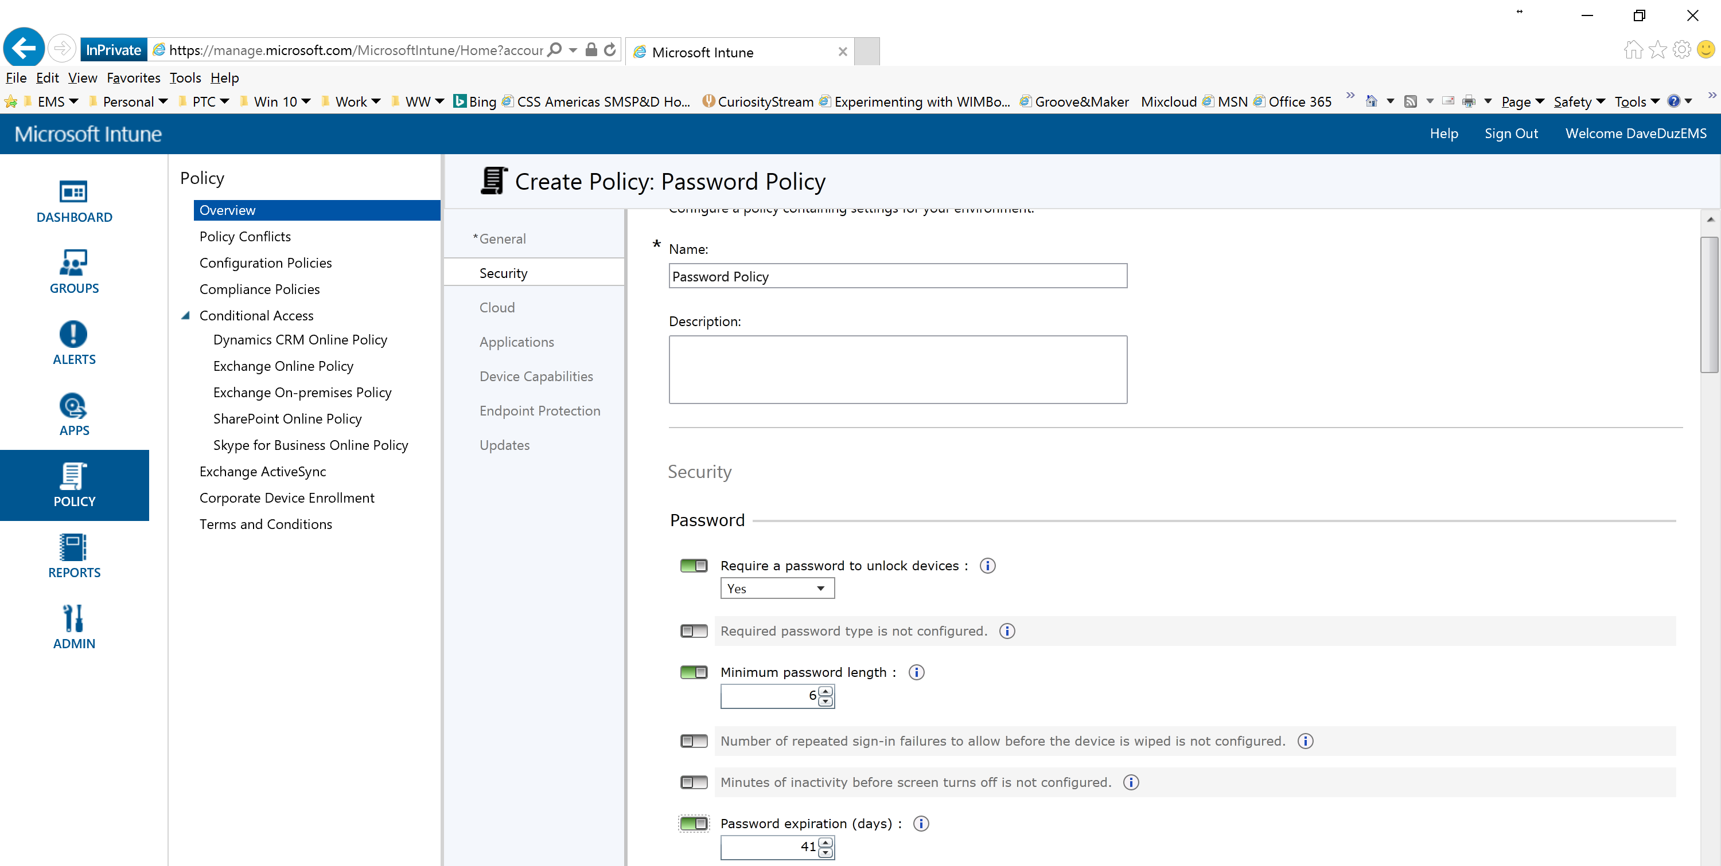
Sample Policy in Intune MinDevicePasswordLength CSP

Slide 9
Sample SyncML - MinDevicePasswordLength
<SyncML xmlns='SYNCML:SYNCML1.2'>
<SyncHdr>
<VerDTD>1.2</VerDTD>
<VerProto>DM/1.2</VerProto>
<SessionID>1</SessionID>
<MsgID>1</MsgID>
<Target>
<LocURI>{unique device ID}</LocURI>
</Target>
<Source>
<LocURI>https://www.contoso.com/mgmt-server</LocURI>
</Source>
</SyncHdr>
<SyncBody>
<!-- update device setting -->
<Replace>
<CmdID>2</CmdID>
<Item>
<Target>
<LocURI>./Vendor/MSFT/Policy/Config/DeviceLock/MinDevicePasswordLength</LocURI>
</Target>
<Meta>
<Type xmlns="syncml:metinf">text/plain</Type>
<Format xmlns="syncml:metinf">int</Format>
</Meta>
<Data>6</Data>
</Item>
</Replace>
<Final />
</SyncBody>
</SyncML>
Device
SyncHeader
OMA-URI
Open Mobile Alliance - Uniform Resource Uniform Resource Identifier
SyncML
SyncBody
Value

Slide 10
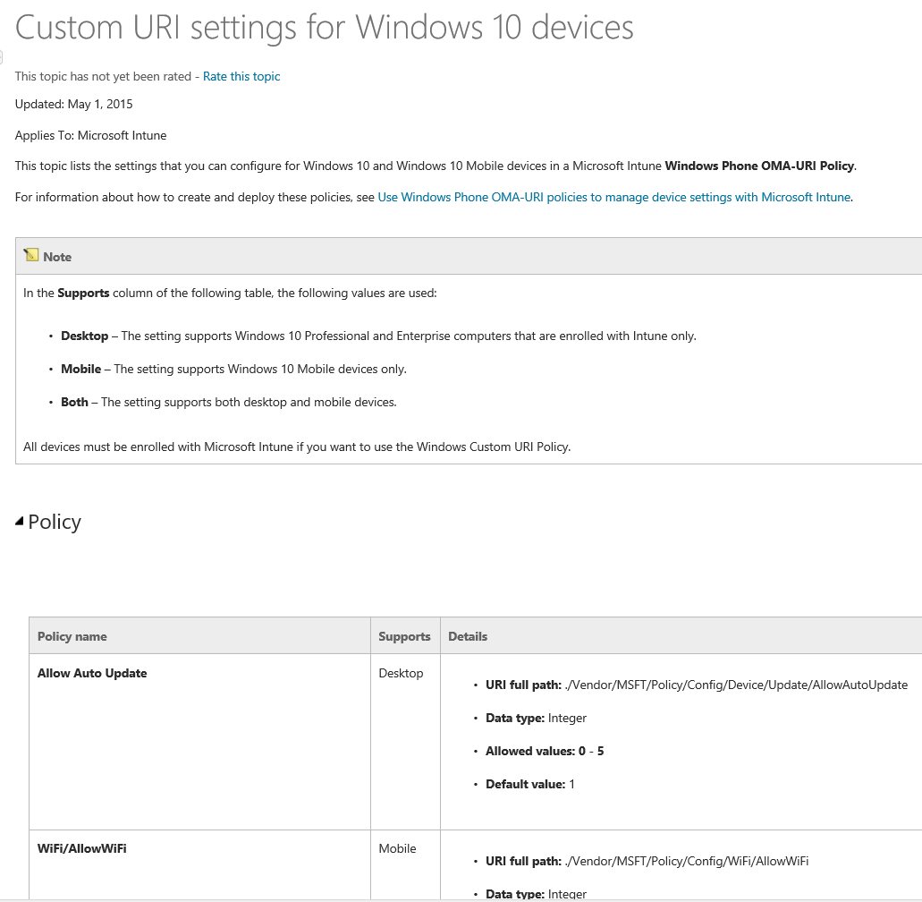
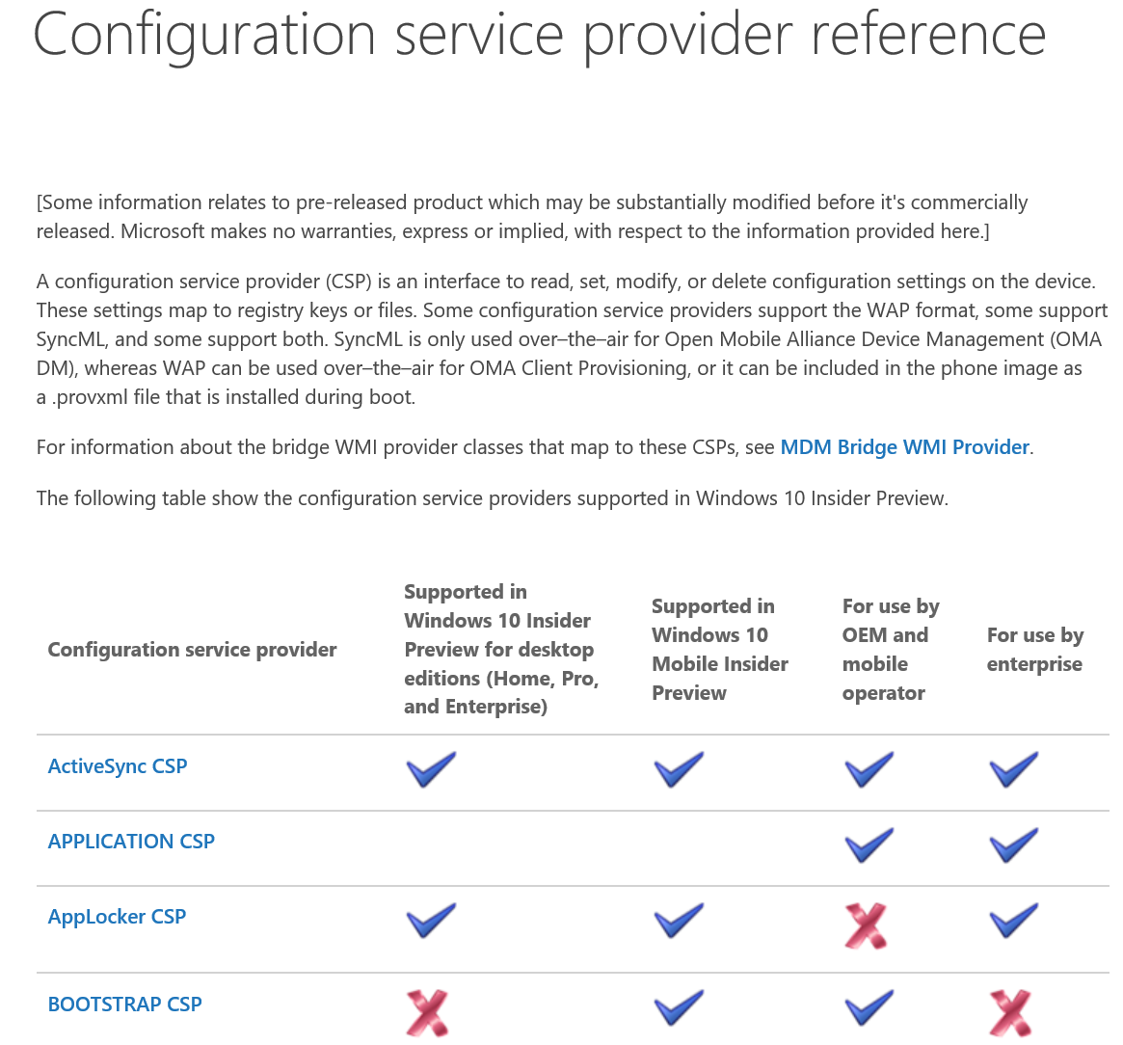
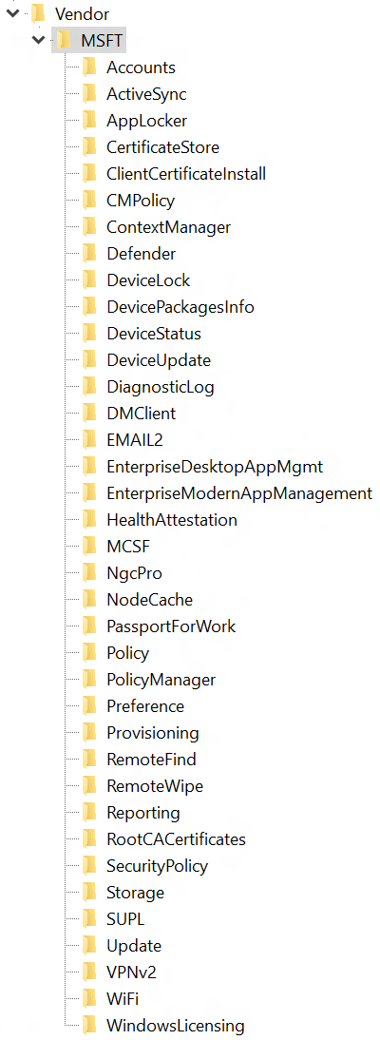
Custom URI settings for Windows 10 devices
References
List of CSP’s: HKLM\SOFTWARE\Microsoft\Provisioning\CSPs\.\Vendor\MSFT
Custom URI settings for Windows 10 devices
Configuration service provider reference

Slide 11
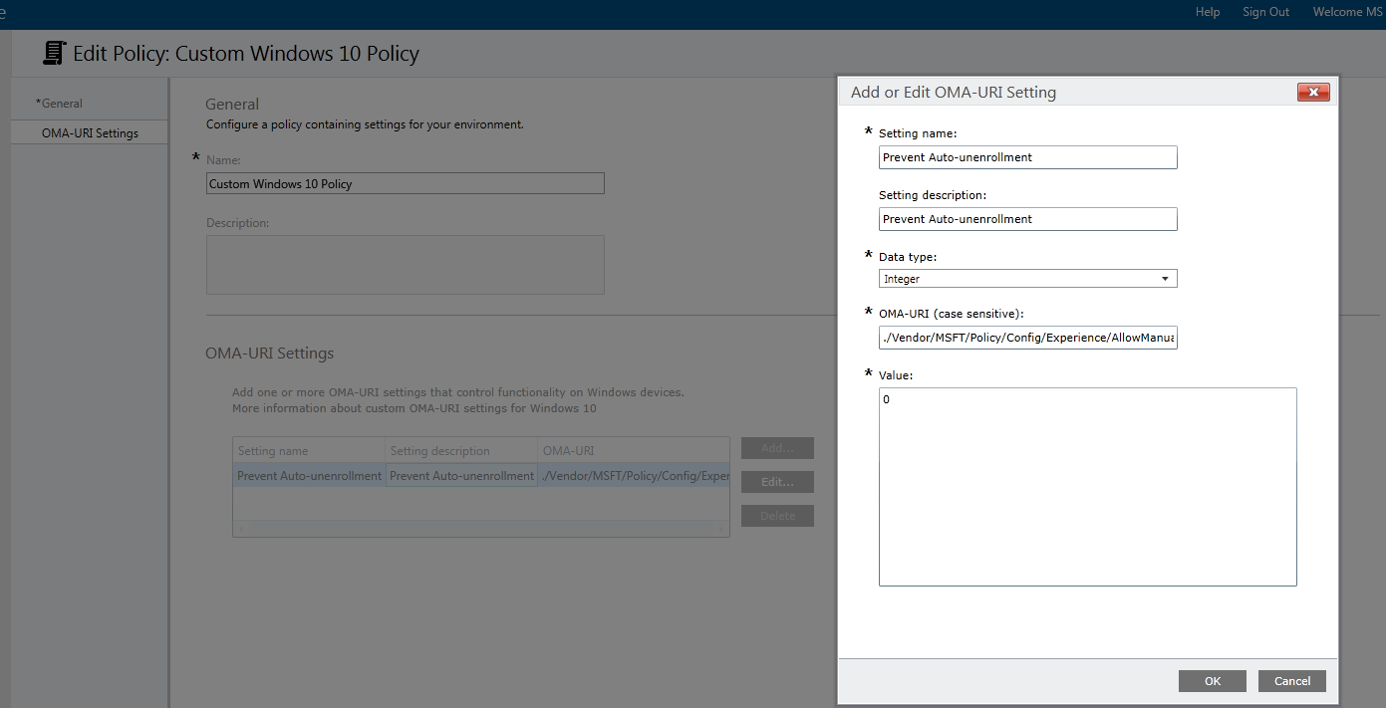

Slide 12
MDM Lifecycle

Slide 13
Mobile Device Management Lifecycle
Un-enrollment with alerts
Removal of configuration
& EDP protected data
Provisioning
Bulk enrollment
Simple bootstrap
Converged protocol
Azure AD Integration
ENROLLMENT
UNENROLLMENT
One consistent set of MDM capabilities across Mobile, Desktop, and IoT
Remote Lock, PIN reset, Ring, Find
Full device wipe
INVENTORY
Enhanced inventory for compliance decisions
Extended set of policies
Context based policies
Client certificates – Direct install (PFX)
Enterprise Wi-Fi profiles
VPN profiles
Email provisioning
MDM Push when user not logged in
Kiosk Mode, Start screen configuration and control
Curated Windows Store Apps
Windows Store for Business
License reclaim/re-use
Enterprise App management
LOB app management
App inventory (MDM/Store)
App allow/deny list
Windows Information protection
REMOTE ASSISTANCE
DEVICE CONFIGURATION AND SECURITY
APPLICATION MANAGEMENT

Slide 14
Management Labs Module 03-01: Set MDM Policies in Intune (EDP, Whitelist Apps..) Module 03-02: Publish LOB App and Business Store App in Intune Module 03-03: Enroll Clients with Intune

